Slide 1
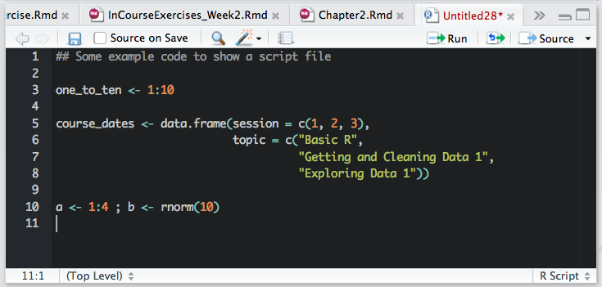
“Save” button
“Run” button
“Source” button
Commented code line
One command across several lines
Two commands on one line

